Slide 1
State Data Systems to Track Program Performance
Gary Bond
Westat
ASPIRE Leadership Training
Sponsored by Office of Disability Employment Policy
U.S. Department of Labor
April 20, 2023

Slide 2
Starting Out: Initial Questions
Why develop an IPS outcome monitoring system?
What do we need to get started?
What outcomes do we collect?
Who collects the data?
Who compiles the data into a data base?
Who creates reports?
What are the contents of the various reports?
Who gets the reports and how often?

Slide 3
Facilitators and Barriers to Outcome Monitoring (Marty, 2008)

Slide 4
Developing an IPS Outcome Monitoring System
Keep it simple. Focus on a few main goals.
Identify your target audiences.
Start at your answer and work backwards.
Use standardized measures whenever possible.
Use two-track data collection: Internal=detailed; External=program-level
In most cases, IPS team leader/local data person compiles data.
In many cases, state data person compiles data and produces reports.
Give frequent, timely, nonpunitive, individualized feedback to IPS team.
Produce timely state reports synchronized to external deadlines.
Summarize data in simple tables. Add graphs to help users visualize.
Compare your data to normed data.

Slide 5
Who are your target audiences?
At local level: IPS team and local agency
Provide data at state level
  For developing and executing state plans
  For explaining IPS to managed care organizations and service providers who have not yet adopted IPS
  For grant applications
  For justifying IPS to other state agencies
  For convincing legislators to provide funding
  For communicating with the public

Slide 6
Planning Outcome Reports:
Graphs and Summaries
Knowing what you want to report helps you decide what to collect
Sample questions for designing graphs:
  What are the trends over time?
  How does my state or program compare to benchmarks?
  At state level, how do programs compare with each other?

Slide 7
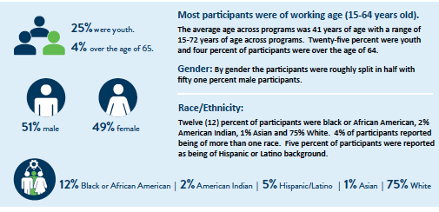
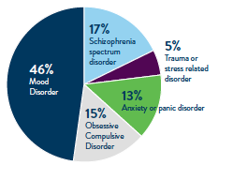
Minnesota’s Annual IPS Report for 2022
Client Characteristics (Courtney, 2023)

Slide 8
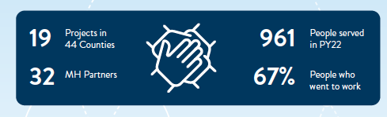
Minnesota’s Annual IPS Report for 2022
Outcomes (Courtney, 2023)
Courtney, C. (2022). Individual Placement and Support for persons with serious mental illness in Minnesota. Report to the legislature as required by Minn. Stat. §268a.15. In: Minnesota Employment and Economic Development, Vocational Rehabilitation Services. Available at: https://www.lrl.mn.gov/docs/2021/mandated/210103.pdf.

Slide 9
Graph Showing Employment Rates Over Time
(Fictitious Data)
Employment Rates: Q1 = 32%, Q2 = 43%, Q3 = 51%

Slide 10
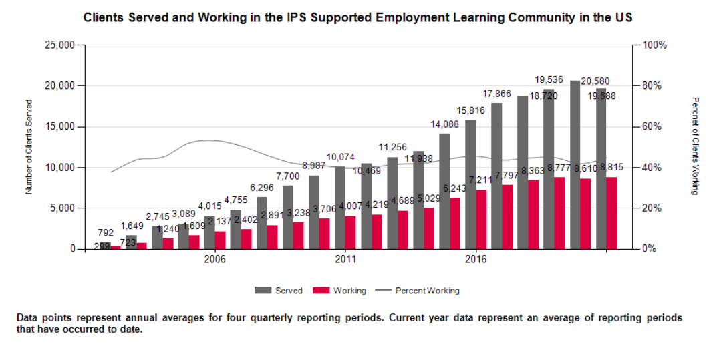
Employment rate for last quarter of 2021: 46.3%
(exceeds 41% benchmark for good outcome)

Slide 11
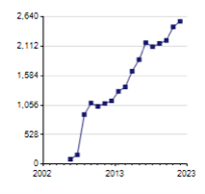
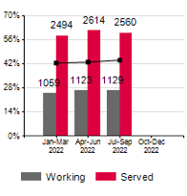
State level data:
Number of clients served by quarter
State-level data:
Percentage of IPS clients working during last three quarters
Other possible graphs:
Number of new enrollees each quarter
Number of terminations each quarter

Slide 12
Data Collection/Data Reporting Relationship
Pitfalls
Collecting data that are never compiled
Collecting data that you may want to use in the future
Reporting outcomes that are out of date
Producing reports that are “data dumps” that do not adequately summarize information

Slide 13
Suggested Outcome Measures
For IPS supervision – IPS team leader usually maintains a spreadsheet
  Demographic sheet (pull from electronic record?)
  Milestone sheet, including:
    Date enrolled
    Date first employer contact
    Date first job start
    Date job ending first job start
    Date terminated
  Job start sheet
    Specifics of job (wage, hours worked, milestones achieved)
For external audiences
  Quarterly employment form – data aggregated quarterly

Slide 14
Outcome Measurement for Local Teams
IPS team leader maintains a spreadsheet with two sheets:
  Demographic sheet (pull from electronic record?)
  Milestone sheet, including:
    Date enrolled
    Date first employer contact
    Date first job start
    Date job ending first job start
    Date terminated from IPS
    Job start details:
    Specifics of job (wage, hours worked, milestones achieved)
    IPS specialist assigned to client
Spreadsheet is cumulative record, contains full record of job starts and endings – used for IPS supervision, VR billing, and other purposes

Slide 15
Outcome Measurement for External Reporting
  One pragmatic strategy: Snapshot of status for a particular reporting period (for example, quarterly)
  Quarterly employment rate:
    Number of clients competitively employed at any time during last 90 days divided by:
    Number of clients on IPS caseload at any time during last 90 days
  Advantages: Easy to compile, benchmarked
  Disadvantages: Does not account for length of time enrolled in IPS, length of employment, etc.

Slide 17
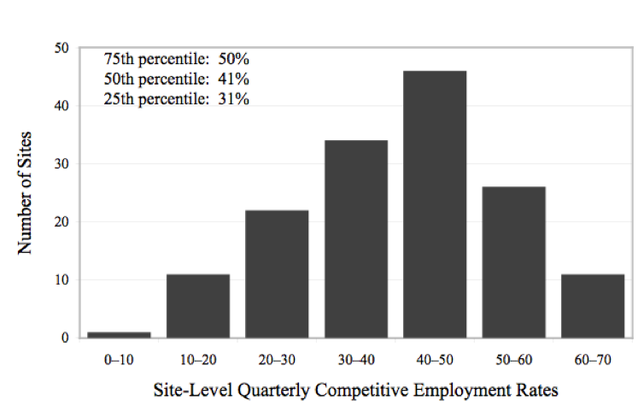
Benchmarks for Quarterly Competitive Employment Outcomes in 151 IPS Programs
Benchmark for good outcome: 41%

Slide 18
Summary
From the standpoint of ASPIRE, state leaders, and IPS programs, the goal is to have procedures that produce:
Statistics on competitive employment outcomes for IPS clients
The employment measures should be:
  Easy to collect and to understand
State data systems are often cumbersome. A local agency’s electronic medical record may be as well. In may cases it’s best to independently collect and compile most IPS data at site level.
IPS data collected at the local level can be aggregated and transmitted to a data monitor at the state level.
But every state is different. State-level portals for data collection work well in some states.

