Slide 1
IPS Research Update
Gary Bond
May 23, 2023
IPS Learning Community Annual Meeting
Salt Lake City, UT

Slide 2
Three Themes in Recent IPS Research
IPS Principles and IPS Fidelity
New Populations
Innovations

Slide 3
New Research on IPS Principles
Open to anyone who wants to work
Focus on competitive employment
Rapid job search
Targeted job development
Client preferences guide decisions
Individualized long-term supports
Integrated with treatment
Personalized benefits counseling

Slide 4
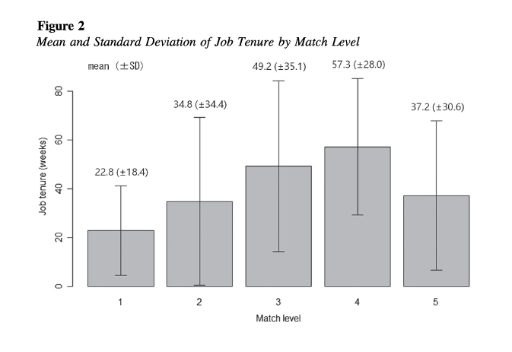
Matching Preferences → Longer Job Tenure
(Igarashi et al., 2022)
At IPS enrollment, clients asked job preference in five areas:
Occupation type
Monthly income
Weekly work hours
Commute time
Illness disclosure
Number of Matches Out of 5 Areas

Slide 5
Personalized Benefits Counseling
Increases Earnings
After receiving specialized benefits counseling, Social Security disability beneficiaries increased mean annual earnings by $1200 (Tremblay et al., 2006)
Observational study using matched sample of 1,926 VR clients with psychiatric disabilities (Kaya, 2023):

Slide 6
New Evidence for IPS Principles:
Summary
Matching client preferences (including all aspects of the job in addition to occupational preferences) increases job tenure
Personalized benefits counseling increases earnings but has at best a small impact on employment rate (that is, the decision to start a job)

Slide 7
IPS Principles Needing More Research
Integration with treatment: How do we achieve that with new populations?
Individualized follow-up: How long, how to ensure warm handoff and long-term support plan?

Slide 8
IPS Fidelity Standard for
Face-to-Face Community Contact
Assumptions underlying Time in Community fidelity item: “Employment services such as engagement, job finding, and follow-along supports provided in community settings.”
Most IPS specialist contacts are face-to-face, and mostly in the community, especially with employers and clients
Online job searches not sufficient – Job development involves building relationships with employers
Contact with mental health professionals includes in-person weekly treatment team meetings

Slide 9
How Should IPS Provide Services?
Impact of COVID Restrictions on IPS
In NY: Reduced fidelity & initial dip in employment rate in March 2020, but quick rebound (Margolies, 2021)
Norwegian study of 25 IPS specialists (Wittlund, 2022):
  Less collaborative engagement with employers and with clinical teams
  More virtual work-related meetings
Since restrictions lifted, many IPS teams continued to rely on virtual meetings

Slide 10
Evidence Supporting the Importance of Community Contact
Assertive community treatment literature has shown much higher rates of client engagement in services than office-based case management
IPS study: Time in community correlated .82 (p < .01) with employment rate (N = 10 sites) (Becker, 2001)

Slide 11
% Time in Community Correlated with Better Employment Outcomes (Margolies, 2023)
IPS teams with 20% or less contact time in the community had poorer employment outcomes

Slide 12
Community Outreach on High-Fidelity IPS Programs in Japan (Yamaguchi, 2020)
Community outreach and individual contact with clients associated with better employment outcomes

Slide 13
Importance of Face-to-Face Contact after Job Start (Bond & Kukla, 2011)
Correlations for frequency of IPS specialist contact with job tenure for 142 clients after first job start:
  Face-to-face contact: 0.27, p < .05
  Telephone contact: 0.01, ns

Slide 14
Importance of Face-to Face Community Contact: Current Evidence
Community outreach to clients likely helps in the engagement process and probably reduces dropouts, but we need IPS-specific research
Time in the community, with face-to-face meetings with employers and clients, may increase overall employment rate and job tenure
Effectiveness of IPS of virtual counseling sessions and virtual meetings with other professionals untested

Slide 15
New Populations
Traumatic Brain Injury
Young Adults with Anxiety and Depression

Slide 16
IPS for Veterans with Traumatic Brain Injury (Pogoda, 2022)
12 VHA medical centers in US
Administrative records for 2020-2022
92 veterans with traumatic brain injury (96% male)
At baseline, unemployed for a median of 5 months
Outcomes
    51% gained employment
    Mean job duration was 3 months
    Disability rating did not correlate with employment!

Slide 17
Research on IPS for Young Adults
Current Status
Findings from a meta-analysis of 7 young adult studies:
  Positive employment outcomes for IPS:
Overall employment rate: 58% for IPS, 32% for controls
  Small positive findings for education outcomes
Most rigorous research on IPS for young adults has been in the first episode psychosis population
But many other subgroups of young adults receiving IPS

Slide 18
Australian IPS for Young Adults
(Simmons et al., 2023)
IPS teams in two headspace centers in Melbourne
Sample consisted of 326 young adults (ages 15-25)
80% had a diagnosis of depressive or anxiety disorder or other nonpsychotic disorder
Fair to good IPS fidelity
Peer worker provided vocational support to 116 (36%) participants requiring additional support

Slide 19
Australian IPS for Young Adults:
Outcomes (Simmons, 2023)
195 (60%) of young adults achieved a competitive job working 15 hours or more per week
55% of jobs sustained for 26 weeks
Young adults with peer support had similar outcomes as those not needing it

Slide 20
US Study of IPS for Young Adults
(Albdulmunem, in press; Bond, in press)
Study conducted from March 2020 to June 2022
9 IPS programs in 5 learning community states (CA, KY, MN, SC, WI)
111 young adults (ages 16-24) enrolled and followed up until termination or one-year follow-up
Fidelity reviews completed using IPS-Y: Adaptation of standard fidelity scale for young adults

Slide 21
IPS for Young Adults
Participant Characteristics (N=111)

Slide 22
IPS for Young Adults:
One-Year Outcomes (N = 111)
Mean program retention: 5 months
Gained employment: 51 (46%)
In education during follow-up: 40 (36%)
Began new education program: 14 (13%)
Employed and/or education: 76 (69%)

Slide 23
Employment Outcomes for Worker Sample

Slide 24
Innovations
People with lived experiences providing IPS (Cook)
Work-focused Cognitive Behavioral Therapy

Slide 25
Effectiveness of Peer-Provided IPS
(Cook et al., 2022)
Peer-run organization provided two types of supported employment services: IPS and Choose-Get-Keep
IPS team achieved good fidelity

Slide 26
Work-Focused Cognitive Behavioral Therapy (CBT) Added to IPS (Kukla et al., 2019)
Standard IPS is not successful for all clients
This pilot offered 12-sessions of CBT for 44 veterans who had remained unemployed on average for a year after enrollment in IPS
After receiving work-focused CBT along with IPS:
  75% worked over 6-month follow-up
  52% were steady workers (worked at least 3 months)

Slide 27
Conclusions Regarding IPS Innovations
People with lived experience can deliver IPS at high fidelity and achieve better employment outcomes compared to using a non-evidence-based service model
Work-focused cognitive behavioral therapy may be a useful adjunct for some client subgroups, such as:
  Workers on sick leave returning to an existing job
Randomized controlled trials needed

Slide 28
Overall Conclusions
IPS principles have held up well over the three decades since Becker and Drake developed IPS
IPS also continues to evolve, with expansion to new populations and testing of innovations
The COVID pandemic led to widespread adoption of telemedicine. We need to rigorously evaluate the effectiveness of IPS services delivered remotely.

