Slide 1
Evidence for the Effectiveness of
Individual Placement and Support Model of Supported Employment
Updated 4-1-21 by Gary Bond

Slide 2
“Employment is a critical mental health intervention.”
Drake and Wallach (2020)
Notes:
Working is often mentioned by clients in describing their recovery process. For example:
J. Bailey, “I’m an Ordinary Person,” Psychiatric Rehabilitation Journal, 22, (1998), 8-10.
Rogers, J. A. (1995). Work is key to recovery. Psychosocial Rehabilitation Journal, 18(4), 5-10.
Steele, K., & Berman, C. (2001). The day the voices stopped. New York: Basic Books.
Hierarchy of needs: Maslow, A. H. (1970). Motivation and personality (2nd ed.): Harper & Row.
Working is not the only adult role for adults in our society, but it is clearly very important. It is each client’s choice whether or not he/she would like to pursue work, but mental health centers should make it possible if it is their choice.

Slide 3
Why Focus on Work for People with Serious Mental Illness?
Most people with mental illness want to work!
Most see work as a key part of recovery
Being productive = Basic human need
In most societies, typical adult role
Working can be a way out of poverty
Working may prevent entry into disability system
Working contributes to better health and well-being
Notes:
Working is often mentioned by clients in describing their recovery process. For example:
J. Bailey, “I’m an Ordinary Person,” Psychiatric Rehabilitation Journal, 22, (1998), 8-10.
Rogers, J. A. (1995). Work is key to recovery. Psychosocial Rehabilitation Journal, 18(4), 5-10.
Steele, K., & Berman, C. (2001). The day the voices stopped. New York: Basic Books.
Hierarchy of needs: Maslow, A. H. (1970). Motivation and personality (2nd ed.): Harper & Row.
Working is not the only adult role for adults in our society, but it is clearly very important. It is each client’s choice whether or not he/she would like to pursue work, but mental health centers should make it possible if it is their choice.

Slide 4
Positive Impact of Competitive Employment on Mental Health and Well-Being
In general population:
Work is beneficial for employee well-being, if:
  good-quality supervision
  positive workplace environment
Benefits even if working as little as 8 hours/week
(Modini, 2016; Kamerāde, 2019)
Notes:
Working is often mentioned by clients in describing their recovery process. For example:
J. Bailey, “I’m an Ordinary Person,” Psychiatric Rehabilitation Journal, 22, (1998), 8-10.
Rogers, J. A. (1995). Work is key to recovery. Psychosocial Rehabilitation Journal, 18(4), 5-10.
Steele, K., & Berman, C. (2001). The day the voices stopped. New York: Basic Books.
Hierarchy of needs: Maslow, A. H. (1970). Motivation and personality (2nd ed.): Harper & Row.
Working is not the only adult role for adults in our society, but it is clearly very important. It is each client’s choice whether or not he/she would like to pursue work, but mental health centers should make it possible if it is their choice.

Slide 5
Positive Impact of Competitive Employment for People with Mental Illness
Benefits of work for people with mental illness similar to those for general population:
  increased self-esteem, improved financial security, reduced mental health symptoms, less social isolation, reduced substance use, and reduced health care costs
(Drake, 2020; Gibbons, 2019; Luciano, 2014)
Notes:
Working is often mentioned by clients in describing their recovery process. For example:
J. Bailey, “I’m an Ordinary Person,” Psychiatric Rehabilitation Journal, 22, (1998), 8-10.
Rogers, J. A. (1995). Work is key to recovery. Psychosocial Rehabilitation Journal, 18(4), 5-10.
Steele, K., & Berman, C. (2001). The day the voices stopped. New York: Basic Books.
Hierarchy of needs: Maslow, A. H. (1970). Motivation and personality (2nd ed.): Harper & Row.
Working is not the only adult role for adults in our society, but it is clearly very important. It is each client’s choice whether or not he/she would like to pursue work, but mental health centers should make it possible if it is their choice.

Slide 6
Negative Impact of Job Loss and Extended Unemployment
Job loss leads to demoralization, lowered self-esteem, social isolation, depression, suicide, substance abuse, health issues
Huge impact on earnings, in both short and long term
Return to work increasingly difficult as time passes
Some laid-off workers never return to the labor force
(especially true for women)
                (Korpi, 2001;Paul, 2009; Roelen, 2012)

Slide 7
Unemployment and Disability Benefits
When people cannot find work, applications surge for disability benefits
During Great Recession of 2008, one million unemployed workers applied for SSDI and over 400,000 new beneficiaries joined disability roles
The disability trap (not working to avoid losing benefits) becomes a way of life
(Maestas, 2018)

Slide 8
After Their First Hospitalization,
Few People with Serious Mental Illness Work
Finnish study using high-quality data from national registry
Employment for people with schizophrenia is <15% every year for 10 years after first psychiatric hospitalization
(Hakulinen et al., 2019)

Slide 9
Need for Employment Services
Over 60% of people with serious mental illness want to work, but less than 20% employed.
Only 2% of people who could benefit have access to effective employment services.
Expressed Interest in Employment
Reported in 11 Surveys

Slide 10


Individual Placement and Support (IPS)
Evidence-Based Supported Employment Model
Developed by Deborah Becker and Robert Drake

Slide 11
Four Trends in IPS Research
Expanding the evidence base
Assessing IPS effectiveness in target subgroups of people with mental illness
Extending IPS to new populations beyond people with severe mental illness
Developing strategies to disseminate, implement, sustain, and expand IPS

Slide 12
Trend 1: Expanding the Evidence Base
Number of studies showing IPS effectiveness continues to grow
Long-term outcomes are more positive than previously known
IPS cost studies are exploring its cost-effectiveness

Slide 13
Day Treatment Conversions to IPS: Common Study Design in 4 Studies
Discontinued day treatment
Reassigned day treatment staff to new positions
Implemented new IPS program
Compared to day treatment sites not converting
Sources: Drake and Becker

Slide 14
Day Treatment Conversion Studies
Comparing 6 Sites Converting to IPS to 4 Control Sites (Not Converting)
Notes:
Bond, G. R. (2004). Supported employment: Evidence for an evidence-based practice. Psychiatric Rehabilitation Journal, 345-359.

Slide 15
Similar Results in All
Day Treatment Conversions
Large increase in employment rates
No negative outcomes (e.g., relapses)
Clients, families, staff liked change
Most former day treatment clients spent more time in community, even those not working
Resulted in cost savings

Slide 16
Randomized Controlled Trials of IPS
Randomized controlled trials (RCTs) are the gold standard in medicine
In the following review, we examined:
  RCTs of IPS for people with serious mental illness
  Included studies if they assessed IPS fidelity
Notes:
Excluded studies comparing standard IPS services to adapted IPS (such as IPS-Lite) or enhanced IPS (such as IPS + cognitive remediation)
Also excluded “enhanced IPS” in three-group designs

Slide 17
Study Characteristics of 28 RCTs (Including 7 Multisite Studies) of IPS for People with Serious Mental Illness

Slide 18
Summary Statistics for RCTs of IPS
12 US RCTs and 16 RCTs in 12 other countries
17/28 studies had at least 18-month follow-up
Total enrollment = 6,468 participants
Most studies recruited participants from community mental health agencies
In most studies, the control group received services as usual (sometimes best practices)

Slide 19
Competitive Employment Rates in 28
Randomized Controlled Trials of IPS

Slide 20
Overall Findings for 28 RCTs
Mean competitive employment rate:
      55% for IPS
      25% for controls
27 of 28 studies found a significant advantage for IPS
Exception: Zhang (2017) from mainland China
  Employment rate: IPS (50%) vs control (33%)
  Job tenure: IPS (25 weeks) vs. control (10 weeks)

Slide 21
IPS Typically Has Better Monthly Employment Rates Example: Mental Health Treatment Study (MHTS)

Slide 22
Compared to usual services, IPS has superior employment outcomes on numerous criteria
33% fewer days to first job
Four times as many weeks worked during follow-up
Triple the earnings from employment
Triple the number working 20 hours/week or more
Greater job satisfaction
(Bond, et al., 2020)

Slide 23
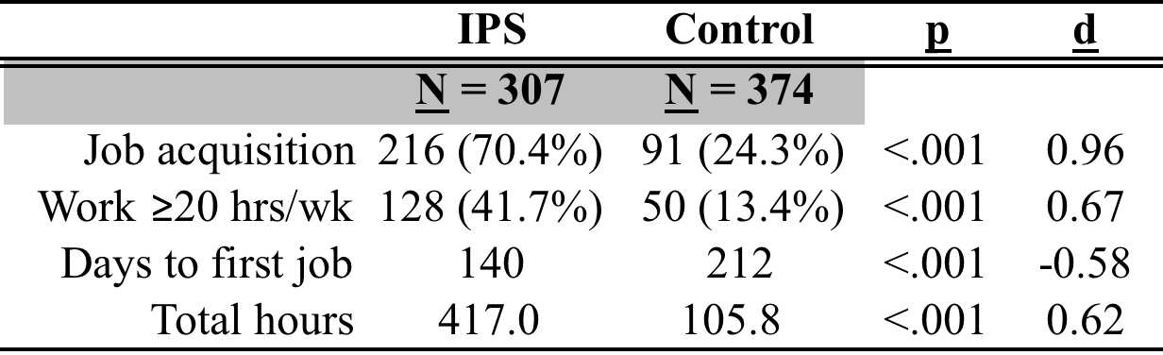
18-Month Competitive Employment Outcomes in 4 Controlled Trials of IPS (Bond et al., 2012)

Slide 24
Mean Job Tenure in Two IPS Studies
Job tenure for IPS was triple that for usual services in Hoffmann study.

Slide 25
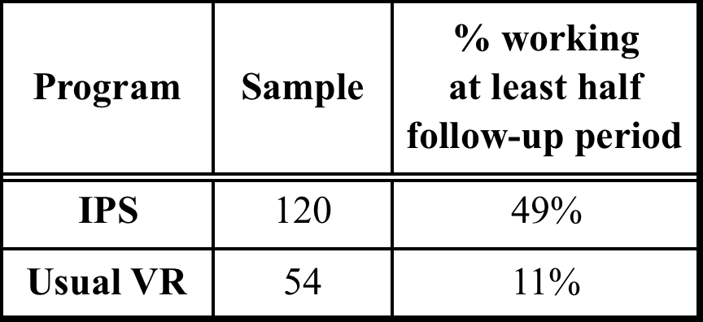
IPS Clients Maintained Steady Employment Over the Long Term in 3 Studies
Follow-up periods: Hoffmann (2014): 5 years;
Salyers (2004): 10 years; Becker (2007) 8-12 years

Slide 26
Long-Term Outcomes for Clients with Severe (46%) and Moderate (54%) Mental Illness

Slide 27
MHTS Long-Term Follow-up Study
SSDI beneficiaries randomly assigned to IPS or control in 23 sites
Social Security numbers were used link participant records to Social Security administrative data for 5 calendar years after the study ended
Length of participant follow-up varied from 7 to 9 years after study enrollment

Slide 28
Long-term follow-up in RCT comparing Treatment (IPS) to Control (no services)
Means annual earnings during 5-year follow-up after end of 2-year study
Long-Term Outcomes from Mental Health Treatment Study for 2,055 Disability Beneficiaries (SSDI)
(Baller et al., 2020)

Slide 29
Summary of MHTS Long-Term Findings
Significant findings favoring treatment group over control group for both employment rate and earnings
Mean earnings for treatment group increased from $2421 to $3368 over 5-year follow-up, while mean earnings for controls remained flat, significantly increasing gap between two groups over time

Slide 30
IPS Has Been Successful in Diverse Locations
IPS is effective in both urban and rural communities
IPS is more effective than standard services across four continents

Slide 31
Barriers to Implementing IPS in Rural Areas
Rural areas require traveling long distances for face-face services
Many rural regions are poor
Rural regions have health care professional shortages

Slide 32
IPS Implementation Barriers and Strategies in Rural Communities: Qualitative Study
Long distances, lack of public transportation and poor internet connectivity require creative strategies to job development and travel
Limited jobs and closeness of business ownership affect job development and follow-along supports
Local culture requires local knowledge and familiarity
Al-Abdulmunem et al. (2021)

Slide 33
IPS Fidelity and Employment Rates Similar in Urban and Rural Communities

Slide 34
(Drake et al., 2018)

Slide 35
Factors Associated with Lower Employment Rates for IPS in Europe
Labor laws and unions protect workers from being terminated, but make it harder for unskilled people to gain work (Brinchmann et al., 2020)
“Disability trap”: Disability policies may discourage return to work
(Burns et al., 2007; Metcalfe et al., 2018)

Slide 36
Systematic Reviews of IPS for People with Serious Mental Illness
Many systematic reviews of IPS literature
Usually limited to randomized controlled trials (RCTs) and focused mainly on competitive employment rate
All conclude: IPS effective in increasing employment
(Bond et al., 2012; Brinchmann et al. 2020; Frederick & VanderWeele, 2019; Kinoshita et al., 2013; Marshall et al., 2014; Metcalfe et al., 2018; Modini et al., 2016; Suijkerbuijk et al., 2017)
Notes:
(Bond et al., 2012; Frederick & VanderWeele, 2019; Kinoshita et al., 2013; Marshall et al., 2014; Metcalfe et al., 2018; Modini et al., 2016)

Slide 37
Cost-Effectiveness of IPS:
Areas of Impact Compared to Controls
Sometimes reduced psychiatric hospital use
In short term, similar or more outpatient treatment
In long term, reduced outpatient treatment
Not yet rigorously studied: IPS impact on general health care, SSI/SSDI, and criminal justice system

Slide 38
IPS Studies of Costs and Cost-Effectiveness

Slide 39
Impact of IPS on Mental Health and Well-Being
In most RCTs, IPS and control groups do not differ in mental health, quality of life, or most other nonvocational outcomes (Kukla & Bond, 2013)
A few exceptions: IPS>controls:
  improved interpersonal relationships (Mueller, 2019)
  Improved mental health and well-being (Drake, 2013)
Notes:
Working is often mentioned by clients in describing their recovery process. For example:
J. Bailey, “I’m an Ordinary Person,” Psychiatric Rehabilitation Journal, 22, (1998), 8-10.
Rogers, J. A. (1995). Work is key to recovery. Psychosocial Rehabilitation Journal, 18(4), 5-10.
Steele, K., & Berman, C. (2001). The day the voices stopped. New York: Basic Books.
Hierarchy of needs: Maslow, A. H. (1970). Motivation and personality (2nd ed.): Harper & Row.
Working is not the only adult role for adults in our society, but it is clearly very important. It is each client’s choice whether or not he/she would like to pursue work, but mental health centers should make it possible if it is their choice.

Slide 40
Trend 2: Assessing IPS Effectiveness in Target Subgroups of People with Mental Illness
Studies show effectiveness of IPS for:
People with justice involvement (3 studies)
People receiving disability benefits (4 studies)
People with co-occurring mental illness and substance use (many studies)
Homeless people with mental illness (3 studies)
Young adults (many studies)

Slide 41
Equality of IPS Access and Outcome for People of Color (Perkins,2021)
UK Study of 779 IPS clients
Equality of access (compared to access to community mental health services):
  Asian access to IPS = White access to IPS
  Black access to IPS = 52% greater than White access
Equality of IPS outcomes (% employed):
Whites (34%); Asians (38%); Blacks (33%)

Slide 42
IPS Is Effective for Many Subgroups of People with Serious Mental Illness (Campbell, 2011)
Different diagnostic groups, including schizophrenia
All age groups and both men and women
Diverse ethno-racial backgrounds
Entire range of work history, including little or none
All levels of educational attainment
Mild or severe psychiatric symptoms
Extensive hospitalization history

Slide 43
Recent Focus on Employment Services for Young Adults
Many different subgroups of young adults:
High school students with psychiatric symptoms
Foster care children being emancipated from child and family services
Young adults with first episode of psychosis
Young adults seeking treatment at community mental health centers

Slide 44
Evaluations of IPS for Young Adults

Slide 45
International Focus on
Employment and Education for Young Adults
Young adults who are not in employment, education, and training (“NEET”) are increasingly entering disability systems in Europe, Australia, and Canada
Helping this group find employment and education could reduce applications for disability benefits

Slide 46
Goals of Young Adults with Early Psychosis (N=63)
Ratings of Importance and Impact on Outcome
Baseline ratings showed work/school ranked as most important goal and predicted participation in work and school at 12 months.
(de Waal et al., 2018)
ªScale: 1=Not at all… 5=Very much

Slide 47
Trend 3: Expanding IPS to New Populations Beyond People with Severe Mental Illness
Research completed or underway for people with:
      Substance use, including opioid addiction
      Autism spectrum disorder
      Intellectual disabilities
      Common mental disorders
      Felony convictions leaving jail or prison
      TANF benefits (Temporary Aid to Needy Families)

Slide 48
Competitive Employment Rates in Controlled Studies of IPS in Other Populations (Bond et al., 2019)
CMD = common mental disorder; Mod = Moderate; PTSD = posttraumatic stress disorder; SUD = substance use disorder

Slide 49
Recent Randomized Controlled Trials of IPS in Other Populations or Specific Subgroups

Slide 50
Emerging Research on IPS for People with Substance Use Disorders
Three multisite RCTs of IPS for people with primary diagnosis of substance use disorder
  IPS-AD – UK study nearing completion (Marsden)
  Norwegian study – (launched in March 2020) (Rognli)
  Project BEES – US study (Baird and Drake)

Slide 51
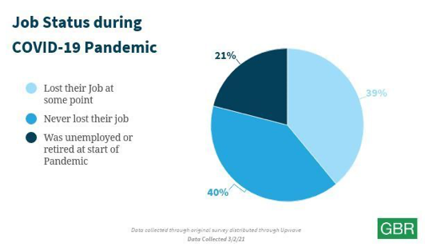
Job Loss During COVID Pandemic:
Should we provide IPS to displaced workers?
22% of Americans who lost jobs during the pandemic remained unemployed as of March 2021
(Bizouati-Kennedy, 2021)
IPS for displaced workers
(Drake, 2021)

Slide 52
Trend 4: Developing Strategies to Disseminate,
Implement, Sustain, and Expand IPS
Scaling Up IPS:
How do we close the gap between:
2% of clients in public mental health system who have access to IPS
60% who express a desire to work competitively

Slide 53
International IPS Learning Community
25 states/regions in the US
4 European countries
Montreal, Canada
New Zealand
(Drake et al., 2020)
https://ipsworks.org

Slide 54
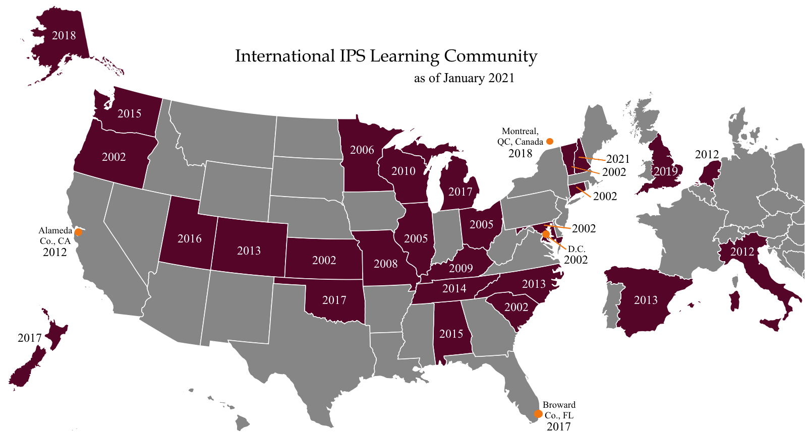
U.S. includes 268 agencies with 353 IPS programs

Slide 55
IPS Learning Community Growth in
Number of IPS Teams in US (2002-2019)
2014: 161
2019: 331
2004: 40
2009: 108
Mean Annual Growth Rate: 25.6%

Slide 56
State Agency Strategies for Promoting IPS
Start small
Secure funding
Ensure interagency collaboration (MH and VR)
Build a learning community among stakeholders
Provide technical assistance
Monitor fidelity and outcome
(Bond et al., 2020)

Slide 57
Learning Community States Provide More State Support for IPS Than Do Other States
(Pogue, 2021)

Slide 58
Learning Community States Access More Funding Sources Than Do Other States
(Pogue, 2021)

Slide 59
More Rapid Growth of IPS Services in Learning Community Than Outside
(Pogue, 2021)

Slide 60
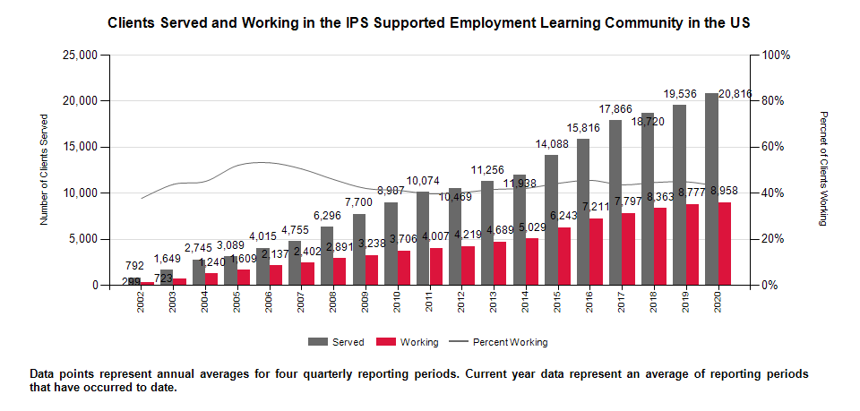
Employment rate for last quarter of 2018: 45%
(exceeds 41% benchmark for good outcome)
Employment rate for October-December 2019: 45.2%
(exceeds 41% benchmark for good outcome)

Slide 61
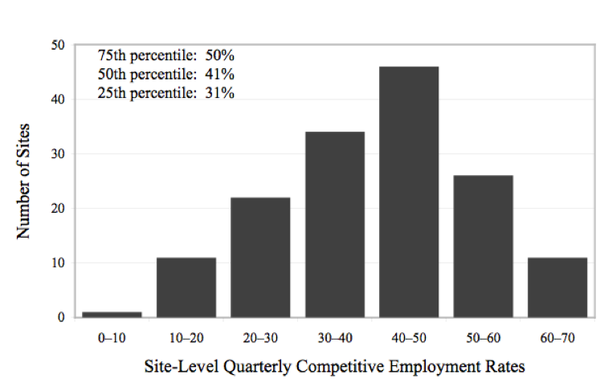
Histogram of Site-Level Employment Rates in IPS Learning Community (2002-2010)
(Drake et al., 2012)
Benchmark for good outcome: 41%

Slide 62
Impact of COVID Pandemic on
Learning Community Employment Rates
IPS Learning Community Quarterly Employment Rates

Slide 63
Most IPS Learning Community Programs
Meet Fidelity Standards (≥100)
(Bond et al., 2012)

Slide 64
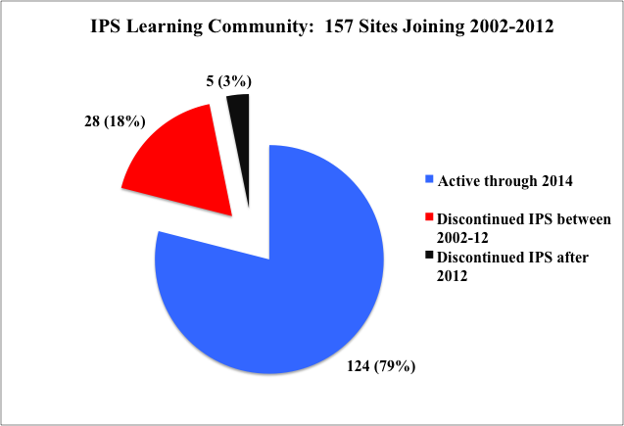
Most IPS Programs within IPS Learning Community Sustain Services for Many Years

Slide 65
IPS Learning Community Shows Growth in Infrastructure, Fidelity, and Outcomes
N=122 IPS programs in 13 states
(Bond et al., 2016)

Slide 66

International Spread of IPS…
to 19 other nations, and counting
687 IPS programs outside US (Knutzen, 2020)

Slide 67
Factors Promoting Spread of IPS Outside US (Drake, 2020)
International consensus that IPS is evidence-based
IPS research studies conducted locally
Dedicated leaders
Technical assistance and fidelity monitoring
National initiatives setting targets for IPS growth
In some countries, rapid growth of long-term disability rolls

Slide 68
Growth in Number of IPS Programs in the Netherlands, 2014-2018
de Winter et al., 2020
Notes:
Bond, G. R. (2004). Supported employment: Evidence for an evidence-based practice. Psychiatric Rehabilitation Journal, 345-359.

Slide 69
High and Low Fidelity Supported Employment Programs in Japan
Programs rated on a modified version of IPS-25
Yamaguchi et al. (2020)

Slide 70
Growing Recognition:
Vocational rehab experts rate IPS as highly relevant (3rd) with strong evidence (3rd)
(Leahy et al., 2018)

Slide 71
Current Trends in IPS:
Overall Conclusions
IPS improves competitive employment outcomes for people with serious mental illness
Its applicability to many other groups is promising
IPS is now available in many countries worldwide
IPS is by far the most extensively and carefully researched of all vocational models
Work is the best treatment we have!

Slide 72
IPS Research Evidence Powerpoint
https://ipsworks.org → Library→ Search for “research”
Powerpoint + reference list + pdf:
Bond, G. R., Drake, R. E., & Becker, D. R. (2020). An update on Individual Placement and Support. World Psychiatry, 19, 390-391.
garybond@westat.com

