Slide 1
Evidence for the Effectiveness of
Individual Placement and Support Model of Supported Employment
Updated 6-18-19 by Gary Bond

Slide 2
Why Focus on Work?
Most clients want to work!
Most clients see work as a key part of recovery
Being productive = Basic human need
In most societies, typical adult role
Working can be a way out of poverty
Working may prevent entry into disability system
Notes:
Working is often mentioned by clients in describing their recovery process. For example:
J. Bailey, “I’m an Ordinary Person,” Psychiatric Rehabilitation Journal, 22, (1998), 8-10.
Rogers, J. A. (1995). Work is key to recovery. Psychosocial Rehabilitation Journal, 18(4), 5-10.
Steele, K., & Berman, C. (2001). The day the voices stopped. New York: Basic Books.
Hierarchy of needs: Maslow, A. H. (1970). Motivation and personality (2nd ed.): Harper & Row.
Working is not the only adult role for adults in our society, but it is clearly very important. It is each client’s choice whether or not he/she would like to pursue work, but mental health centers should make it possible if it is their choice.

Slide 3
Need for Employment Services
Over 60% clients with severe mental illness want to work, but less than 20% employed.
Only 2% of people who could benefit have access to effective employment services.
Expressed Interest in Employment
Reported in 11 Surveys

Slide 4
Four Trends in IPS Research
Expanding the evidence base
Assessing applicability of IPS for target subgroups
Extending IPS to groups beyond people with severe mental illness
Developing strategies to disseminate, implement, sustain, and expand IPS

Slide 5
1. Expanding the evidence base
Number of studies showing IPS effectiveness continues to grow
Long-term outcomes are more positive than previously known
IPS produces a good return on investment
Steady employment promotes improvement in other life domains

Slide 6
Day Treatment Conversions to IPS: Common Study Design in 4 Studies
Discontinued day treatment
Reassigned day treatment staff to new positions
Implemented new IPS program
Compared to day treatment sites not converting
Sources: Drake and Becker

Slide 7
Day Treatment Conversion Studies:
6 Sites Converting to IPS vs. 4 Control Sites (Not Converting)
Notes:
Bond, G. R. (2004). Supported employment: Evidence for an evidence-based practice. Psychiatric Rehabilitation Journal, 345-359.

Slide 8
Similar Results in All
Day Treatment Conversions
Large increase in employment rates
No negative outcomes (e.g., relapses)
Clients, families, staff liked change
Most former day treatment clients spent more time in community, even those not working
Resulted in cost savings

Slide 9
Systematic Reviews of IPS for People with Serious Mental Illness
Many systematic reviews of IPS literature
Usually limited to randomized controlled trials (RCTs) and focused mainly on competitive employment rate
All conclude: IPS effective in increasing employment
(Recent reviews: Bond et al., 2012; Frederick & VanderWeele, 2019; Kinoshita et al., 2013; Marshall et al., 2014; Metcalfe et al., 2018; Modini et al., 2016)
Notes:
(Bond et al., 2012; Frederick & VanderWeele, 2019; Kinoshita et al., 2013; Marshall et al., 2014; Metcalfe et al., 2018; Modini et al., 2016)

Slide 10
Compilation of 26 IPS RCTs as of May 2019
RCTs of IPS for people with serious mental illness
Included studies if they assessed IPS fidelity
Excluded studies comparing standard IPS services to adapted IPS (such as IPS-Lite) or augmented IPS (such IPS + cognitive remediation)

Slide 11
Study Characteristicsof 26 RCTs of IPS for People with Serious Mental Illness

Slide 12
Characteristics of RCTs of IPS
12 U.S. studies and 14 outside U.S.
2/3 of studies had at least 18-month follow-up
Total enrollment = 5,877 participants
In most studies, participants mainly recruited from community mental health services
In most studies, the control group received services as usual (sometimes best practices)

Slide 13
Competitive Employment Rates in 26 Randomized Controlled Trials of IPS

Slide 14
Overall Findings for 26 RCTs
25 of 26 studies showed a significant advantage for IPS
(Exception: Study in mainland China was borderline significant)
Mean competitive employment rates for the 26 studies:
      55% for IPS
      23% for controls

Slide 15
IPS Competitive Employment Rates Similar in Large Cities and Rural Communities (Haslett, 2011)

Slide 16
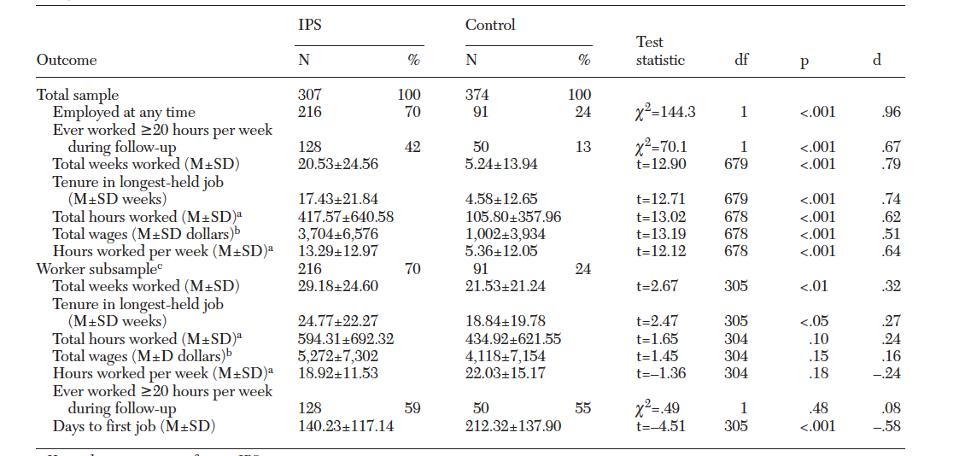
18-Month Competitive Employment Outcomes in
Meta-Analysis of 4 RCTs of IPS (Bond et al., 2012)

Slide 17
Mean Job Tenure in Two IPS Studies
Job tenure for IPS was triple that for usual services in Hoffmann study.

Slide 18
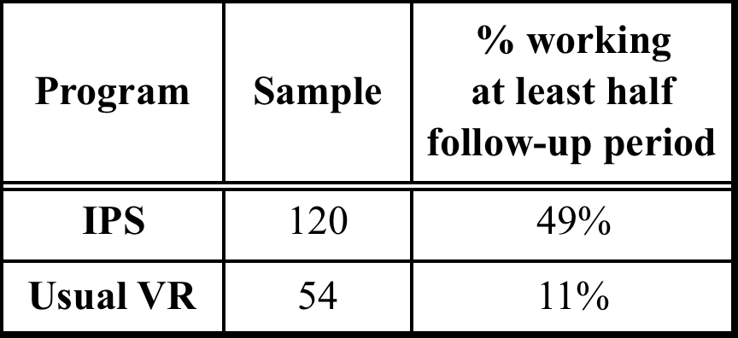
Steady Worker Rate in 3 Long-Term Studies
Follow-up periods: Hoffmann (2014): 5 years;
Salyers (2004): 10 years; Becker (2007) 8-12 years

Slide 19
Mental Health Treatment Study: Long-term Follow-up (6-8 years) (Baller et al., 2018)

Slide 20
Cost-Effectiveness of IPS:
Areas of Impact Compared to Controls
Sometimes reduced psychiatric hospital use
In short term, similar or more outpatient treatment
In long term, reduced outpatient treatment
Not yet rigorously studied: IPS impact on general health care, SSI/SSDI, and criminal justice system

Slide 21
5-Year Return on Investment for IPS and Traditional Voc Services (Hoffmann, 2014)
For every $1 spent on spent on services,
Return in employment earnings =
44¢ for IPS
13¢ for traditional
vocational services

Slide 22
Impact of IPS on Mental Health and Well-Being
In most controlled trials, IPS and control groups do not differ in mental health, quality of life, or other nonvocational outcomes
One exception: In some studies, IPS clients have reduced use of mental health services, especially psychiatric hospitalizations
(Kukla & Bond, 2013)
Notes:
Working is often mentioned by clients in describing their recovery process. For example:
J. Bailey, “I’m an Ordinary Person,” Psychiatric Rehabilitation Journal, 22, (1998), 8-10.
Rogers, J. A. (1995). Work is key to recovery. Psychosocial Rehabilitation Journal, 18(4), 5-10.
Steele, K., & Berman, C. (2001). The day the voices stopped. New York: Basic Books.
Hierarchy of needs: Maslow, A. H. (1970). Motivation and personality (2nd ed.): Harper & Row.
Working is not the only adult role for adults in our society, but it is clearly very important. It is each client’s choice whether or not he/she would like to pursue work, but mental health centers should make it possible if it is their choice.

Slide 23
Impact of IPS on social functioning in veterans with PTSD (Mueller et al. 2019)
Randomized controlled trial comparing IPS to Transitional Work Program (TWP) over 18 months
541 veterans with PTSD completed a role functioning checklist at 3-month intervals
IPS group improved from baseline at every follow-up
TWP group worsened at every follow-up
Findings independent of employment outcomes

Slide 24
Impact of Competitive Employment on Mental Health and Well-Being
In general population:
Work is beneficial for employee well-being, if:
  good-quality supervision
  positive workplace environment
Unemployment has consistently negative effects
(Modini et al. (2016)
Notes:
Working is often mentioned by clients in describing their recovery process. For example:
J. Bailey, “I’m an Ordinary Person,” Psychiatric Rehabilitation Journal, 22, (1998), 8-10.
Rogers, J. A. (1995). Work is key to recovery. Psychosocial Rehabilitation Journal, 18(4), 5-10.
Steele, K., & Berman, C. (2001). The day the voices stopped. New York: Basic Books.
Hierarchy of needs: Maslow, A. H. (1970). Motivation and personality (2nd ed.): Harper & Row.
Working is not the only adult role for adults in our society, but it is clearly very important. It is each client’s choice whether or not he/she would like to pursue work, but mental health centers should make it possible if it is their choice.

Slide 25
Impact of Competitive Employment on Mental Health and Well-Being
For people with serious mental illness:
Work is beneficial in these areas:
  Self esteem – 100% (3/3 studies)
  Psychiatric symptoms – 57% (4/7 studies)
  Life satisfaction – 33% (3/9 studies)
  (Luciano, Bond, & Drake, 2014)
Notes:
Working is often mentioned by clients in describing their recovery process. For example:
J. Bailey, “I’m an Ordinary Person,” Psychiatric Rehabilitation Journal, 22, (1998), 8-10.
Rogers, J. A. (1995). Work is key to recovery. Psychosocial Rehabilitation Journal, 18(4), 5-10.
Steele, K., & Berman, C. (2001). The day the voices stopped. New York: Basic Books.
Hierarchy of needs: Maslow, A. H. (1970). Motivation and personality (2nd ed.): Harper & Row.
Working is not the only adult role for adults in our society, but it is clearly very important. It is each client’s choice whether or not he/she would like to pursue work, but mental health centers should make it possible if it is their choice.

Slide 26
Large-Sample Study of Impact of Employment on Mental Health (Gibbons & Salkever, 2019)
Longitudinal study of administrative data for 5,162 clients with mental illness in public MH system
Working had a small positive impact on mental health (after controlling for selection bias)
Employment reduced total mental health costs on average by $538 in a 6-month period
Notes:
Working is often mentioned by clients in describing their recovery process. For example:
J. Bailey, “I’m an Ordinary Person,” Psychiatric Rehabilitation Journal, 22, (1998), 8-10.
Rogers, J. A. (1995). Work is key to recovery. Psychosocial Rehabilitation Journal, 18(4), 5-10.
Steele, K., & Berman, C. (2001). The day the voices stopped. New York: Basic Books.
Hierarchy of needs: Maslow, A. H. (1970). Motivation and personality (2nd ed.): Harper & Row.
Working is not the only adult role for adults in our society, but it is clearly very important. It is each client’s choice whether or not he/she would like to pursue work, but mental health centers should make it possible if it is their choice.

Slide 27
2. Assessing applicability of IPS in target subgroups of people with mental illness
Studies show effectiveness of IPS for:
People with justice involvement (2 studies)
People receiving disability benefits (4 studies)
People with co-occurring substance use (many)
Young adults (many)

Slide 28
IPS Is Effective Across Many Subgroups of People with Serious Mental Illness (Campbell, 2011)
Different diagnostic groups, including schizophrenia
All age groups
Diverse ethnoracial backgrounds
Both extensive and little or no work history
All levels of educational attainment
Mild or severe psychiatric symptoms
Extensive hospitalization history

Slide 29
Meta-Analysis of 4 RCTs of IPS for Clients with Mental Illness and Substance Use Disorder
Mueser et al. (2011)

Slide 30
Recent Focus on Employment Services for Young Adults
Many different subgroups of young adults:
Transition age youth (16-26, as targeted by WIOA)
Foster care children being emancipated from child and family services
Young adults with first episode of psychosis
Young adults (under 30) receiving community mental health services

Slide 31
Goals of Young Adults with FEP (N=63)
Ratings of Importance and Impact on Outcome
Baseline ratings of importance for work/school were highest and predicted work/school participation at 12 months.
(de Waal et al., 2018)
ªScale: 1=Not at all… 5=Very much

Slide 32
Employment Outcomes in Early Psychosis Programs Comparing Programs With and Without IPS (8 Studies)
(Bond et al., 2015)

Slide 33
18-Month Outcomes for Youth (Under 30)
Enrolled in 4 IPS Controlled Trials
(Bond et al., 2016)

Slide 34
International Focus on
Employment and Education for Young Adults
Young adults who are not in employment, education, and training (“NEET”) are increasingly entering disability systems in Europe, Australia, and Canada
Helping this group find employment and education could reduce applications for disability benefits

Slide 35
Supported Employment & preventing Early Disability
Norwegian SEED trial (Sveinsdottir et al., 2019)
3-year study of 116 IPS clients
46 (40%) gained employment within two years
Compared workers to nonworkers on 3rd year QOL
↑QOL Physical (energy, mobility) p = .002
↑QOL Psychological (self esteem) p = .001
↑QOL Social and QOL Environment p < .07
RCT of IPS for 96 young adults on temporary benefits for health problems and at risk for early work disability
Control group offered traditional vocational rehabilitation (sheltered work)
One-year competitive employment rates (self-report):
48% of IPS group versus 8% of control group
IPS group reported better health outcomes, increased optimism, less hopelessness (compared to controls)

Slide 36
3. Expanding IPS to new populations
Preliminary research completed or underway for people with:
      Autism spectrum disorder
      Intellectual disabilities
      Common mental disorders
      Chronic medical conditions
      TANF benefits (Temporary Aid to Needy Families)

Slide 37
Competitive Employment Rates in Controlled Studies of IPS in Other Populations (Bond et al., 2019)
CMD = common mental disorder; Mod = Moderate; PTSD = posttraumatic stress disorder; SUD = substance use disorder

Slide 38
4. Developing strategies to disseminate, implement, sustain, and expand IPS
Scaling Up IPS:
How do we close the gap between:
2% of clients in public mental health system who have access to IPS
60% who express a desire to work competitively

Slide 39
International IPS Learning Community
24 states/regions in the US
4 European countries
Montreal, Canada
New Zealand
https://ipsworks.org

Slide 40
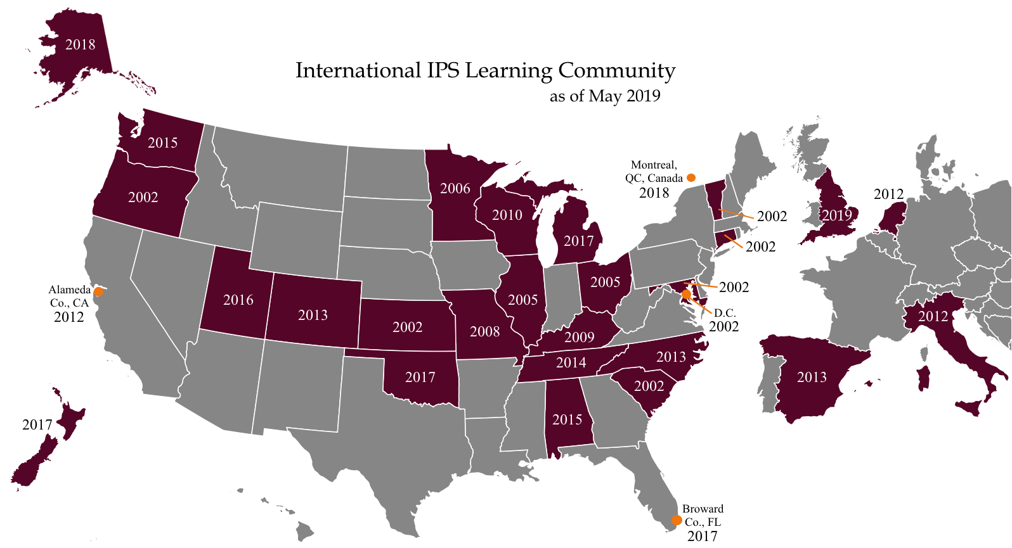
U.S. includes 243 agencies with 309 IPS teams
U.S. includes 243 agencies with 309 IPS teams

Slide 41
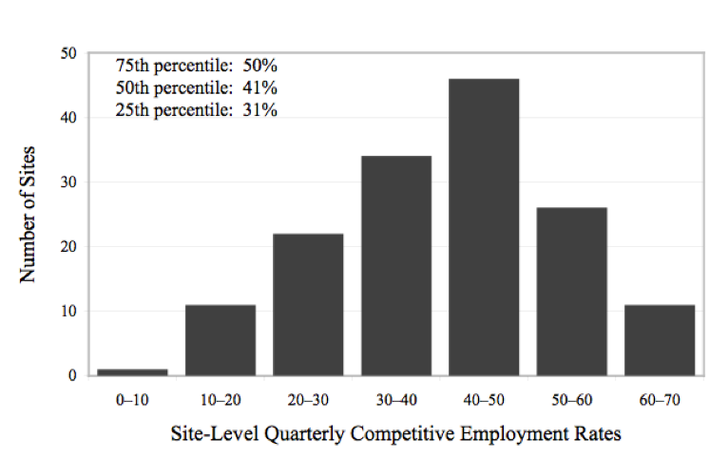
Histogram of Site-Level Employment Rates in IPS Learning Community (2002-2010)
(Drake et al., 2012)
Benchmark for good outcome: 41%

Slide 42
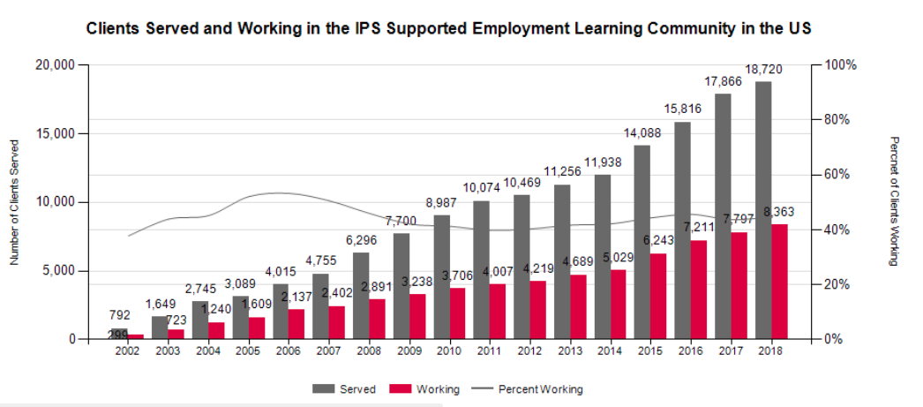
Employment rate for last quarter of 2018: 45%
(exceeds 41% benchmark for good outcome)

Slide 43
Most IPS Learning Community programs meet fidelity standards (≥100)
(Bond et al., 2012)

Slide 44
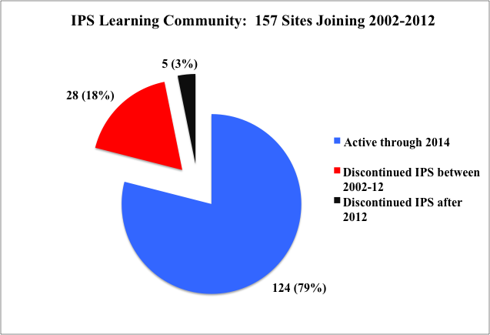
Most IPS Programs within IPS Learning Community Sustain Services for Many Years

Slide 45
IPS Learning Community Shows Growth in Infrastructure, Fidelity, and Outcomes
N=122 IPS programs in 13 states
(Bond et al., 2016)

Slide 46

International Spread of IPS…
to 20 other nations, and counting

Slide 47
Factors Promoting Spread of IPS Outside US (18 other countries)
International consensus
Local research studies
Rapid growth of long-term disability rolls
National guidelines

Slide 48
(Drake et al., 2018)

Slide 49
Factors Associated with Lower Employment Rates for IPS in Europe
Labor laws and unions protect workers who are employed, but make it harder for unskilled people to gain work
“Disability trap”: Disability policies may discourage return to work
(Burns et al., 2007; Metcalfe et al., 2018)

Slide 50
Growing Recognition:
Vocational rehab experts rate IPS as highly relevant (3rd) with strong evidence (3rd)
(Leahy et al., 2018)

Slide 51
Current Trends in IPS:
Overall Conclusions
Amazing growth and attention to IPS worldwide
IPS has “scaled up and out” in many directions – new countries, new populations, new IPS teams
Research has examined numerous dimensions of IPS
Because of extensive research, we know more about IPS than any other vocational intervention
Work is the best treatment we have!

