Slide 1
New IPS Research Findings
Gary Bond
May 23, 2019
IPS Learning Community Annual Meeting
Denver, CO

Slide 2
Recent Trends in IPS Research and Practice
Research on impact of IPS on non-work domains
Expansion of IPS to new populations
Focus on young adults
Expansion of IPS services within IPS Learning Community

Slide 3
Impact of IPS on Mental Health and Well-Being
In most controlled trials, IPS and control groups do not differ in mental health, quality of life, or other nonvocational outcomes
One exception: In some studies, IPS clients have reduced use of mental health services, especially psychiatric hospitalizations
(Kukla & Bond, 2013)
Notes:
Working is often mentioned by clients in describing their recovery process. For example:
J. Bailey, “I’m an Ordinary Person,” Psychiatric Rehabilitation Journal, 22, (1998), 8-10.
Rogers, J. A. (1995). Work is key to recovery. Psychosocial Rehabilitation Journal, 18(4), 5-10.
Steele, K., & Berman, C. (2001). The day the voices stopped. New York: Basic Books.
Hierarchy of needs: Maslow, A. H. (1970). Motivation and personality (2nd ed.): Harper & Row.
Working is not the only adult role for adults in our society, but it is clearly very important. It is each client’s choice whether or not he/she would like to pursue work, but mental health centers should make it possible if it is their choice.

Slide 4
Impact of IPS on social functioning in veterans with PTSD (Mueller et al., 2019)
Randomized controlled trial (RCT) comparing IPS to Transitional Work Program (TWP) over 18 months
541 veterans with PTSD completed a role functioning checklist at 3-month intervals
IPS group improved from baseline at every follow-up
TWP group worsened from baseline at every follow-up
Findings independent of employment outcomes

Slide 5
Impact of Competitive Employment on Mental Health and Well-Being
In general population:
Work is beneficial for employee well-being, if:
  high-quality supervision
  positive workplace environment
Unemployment has strong negative effects
(Modini et al. (2016)
Notes:
Working is often mentioned by clients in describing their recovery process. For example:
J. Bailey, “I’m an Ordinary Person,” Psychiatric Rehabilitation Journal, 22, (1998), 8-10.
Rogers, J. A. (1995). Work is key to recovery. Psychosocial Rehabilitation Journal, 18(4), 5-10.
Steele, K., & Berman, C. (2001). The day the voices stopped. New York: Basic Books.
Hierarchy of needs: Maslow, A. H. (1970). Motivation and personality (2nd ed.): Harper & Row.
Working is not the only adult role for adults in our society, but it is clearly very important. It is each client’s choice whether or not he/she would like to pursue work, but mental health centers should make it possible if it is their choice.

Slide 6
Impact of Competitive Employment on Mental Health and Well-Being
For people with serious mental illness:
Work is beneficial in these areas:
  Self esteem – 100% (3/3 studies)
  Psychiatric symptoms – 57% (4/7 studies)
  Life satisfaction – 33% (3/9 studies)
  (Luciano, Bond, & Drake, 2014)
Notes:
Working is often mentioned by clients in describing their recovery process. For example:
J. Bailey, “I’m an Ordinary Person,” Psychiatric Rehabilitation Journal, 22, (1998), 8-10.
Rogers, J. A. (1995). Work is key to recovery. Psychosocial Rehabilitation Journal, 18(4), 5-10.
Steele, K., & Berman, C. (2001). The day the voices stopped. New York: Basic Books.
Hierarchy of needs: Maslow, A. H. (1970). Motivation and personality (2nd ed.): Harper & Row.
Working is not the only adult role for adults in our society, but it is clearly very important. It is each client’s choice whether or not he/she would like to pursue work, but mental health centers should make it possible if it is their choice.

Slide 7
Impact of Work on Quality of Life (QOL)
(Rössler et al., 2018)
3-year study of 116 IPS clients
46 (40%) gained employment within two years
Comparing workers to nonworkers on 3rd year QOL:
↑QOL Physical (energy, mobility) p = .002
↑QOL Psychological (self esteem) p = .001
↑QOL Social and QOL Environment p < .07

Slide 8
Impact on Work on Hospitalization and
Quality of Life (Jäckel et al., 2018)
3-year study of 116 IPS clients
46 (40%) gained employment within two years
Compared workers to nonworkers on 3rd year QOL
↑QOL Physical (energy, mobility) p = .002
↑QOL Psychological (self esteem) p = .001
↑QOL Social and QOL Environment p < .07
5-year study of 85 clients (IPS + control)
IPS had no direct effect on nonvocational outcomes
Work decreased hospitalization and increased QOL

Slide 9
Large-Sample Study of Impact of Employment on Mental Health (Gibbons & Salkever, 2019)
Longitudinal study of administrative data for 5,162 clients with mental illness in public MH system
Being employed had a small positive impact on mental health (after controlling for selection bias)
Employment reduced total mental health costs on average by $538 over a 6-month period
Notes:
Working is often mentioned by clients in describing their recovery process. For example:
J. Bailey, “I’m an Ordinary Person,” Psychiatric Rehabilitation Journal, 22, (1998), 8-10.
Rogers, J. A. (1995). Work is key to recovery. Psychosocial Rehabilitation Journal, 18(4), 5-10.
Steele, K., & Berman, C. (2001). The day the voices stopped. New York: Basic Books.
Hierarchy of needs: Maslow, A. H. (1970). Motivation and personality (2nd ed.): Harper & Row.
Working is not the only adult role for adults in our society, but it is clearly very important. It is each client’s choice whether or not he/she would like to pursue work, but mental health centers should make it possible if it is their choice.

Slide 10
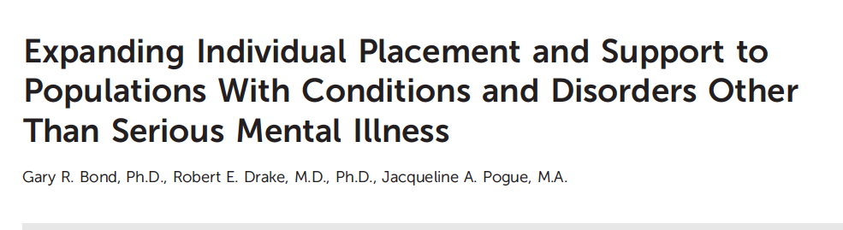

Extending IPS to New Populations
Notes:
Working is often mentioned by clients in describing their recovery process. For example:
J. Bailey, “I’m an Ordinary Person,” Psychiatric Rehabilitation Journal, 22, (1998), 8-10.
Rogers, J. A. (1995). Work is key to recovery. Psychosocial Rehabilitation Journal, 18(4), 5-10.
Steele, K., & Berman, C. (2001). The day the voices stopped. New York: Basic Books.
Hierarchy of needs: Maslow, A. H. (1970). Motivation and personality (2nd ed.): Harper & Row.
Working is not the only adult role for adults in our society, but it is clearly very important. It is each client’s choice whether or not he/she would like to pursue work, but mental health centers should make it possible if it is their choice.

Slide 11
Why Extend IPS to New Populations?
Many other groups have poor employment outcomes
Outside of IPS, few evidence-based vocational models
IPS principles are practical, grounded in clinical experience, and evidence-based
IPS not aimed at psychiatric symptoms
Is IPS suitable and effective for other groups?
Notes:
Working is often mentioned by clients in describing their recovery process. For example:
J. Bailey, “I’m an Ordinary Person,” Psychiatric Rehabilitation Journal, 22, (1998), 8-10.
Rogers, J. A. (1995). Work is key to recovery. Psychosocial Rehabilitation Journal, 18(4), 5-10.
Steele, K., & Berman, C. (2001). The day the voices stopped. New York: Basic Books.
Hierarchy of needs: Maslow, A. H. (1970). Motivation and personality (2nd ed.): Harper & Row.
Working is not the only adult role for adults in our society, but it is clearly very important. It is each client’s choice whether or not he/she would like to pursue work, but mental health centers should make it possible if it is their choice.

Slide 12
All Studies (Including Observational and Protocols)

Slide 13
RCTs Included in Systematic Review

Slide 14
Competitive Employment Rates in 9 RCTs of IPS in New Populations
CMD = common mental disorder; Mod = Moderate; PTSD = posttraumatic stress disorder; SUD = substance use disorder

Slide 15
National and International Focus on
Employment and Education for Young Adults
Rehabilitation Services Administration (WIOA):
Transition-age youth and young adults (age 16-26)
National Institute of Mental Health:
First episode of psychosis (FEP)
SAMHSA Transformation Grants
Young adults who are “NEET” increasingly entering disability systems in Europe, Australia, and Canada

Slide 16
Recent and Planned Research on IPS for Young Adults
Evaluating impact of IPS on young adults at risk for long-term disability
Documenting priority of work/education
Assessing role of work/school goals on outcomes
Assessing role of work on engagement in treatment services
Adapting IPS fidelity scale for young adults

Slide 17
Supported Employment & preventing Early Disability
Norwegian SEED trial (Sveinsdottir et al., accepted)
3-year study of 116 IPS clients
46 (40%) gained employment within two years
Compared workers to nonworkers on 3rd year QOL
↑QOL Physical (energy, mobility) p = .002
↑QOL Psychological (self esteem) p = .001
↑QOL Social and QOL Environment p < .07
RCT of IPS for 96 young adults on temporary benefits for health problems and at risk for early work disability
Control group offered traditional vocational rehabilitation (sheltered work)
One-year competitive employment rates (self-report):
48% of IPS group versus 8% of control group
IPS group reported better health outcomes, increased optimism, less hopelessness (compared to controls)

Slide 18

Goals of Young Adults with FEP (N=63)
Ratings of Importance and Impact on Outcome
Baseline ratings of importance for work/school were highest and predicted work/school participation at 12 months.
(de Waal et al., 2017)
Scale: 1=Not at all… 5=Very much

Slide 19
Role of Work in Sustaining Young Adult Engagement in Treatment
At enrollment into a first episode psychosis program, vocationally active and inactive young adults equally likely to successfully meet goals (N=394)
But, remaining vocationally inactive for 12 months leads to dropping out of treatment
Interpretation: Getting a job is a motivator
(Maraj et al., 2019)

Slide 20
IPS Fidelity Scale for Young Adults
Approach to Creating New Scale
Build on validated scale (IPS-25)
Ensure suitability for a wide range of young adult subgroups
New scale easily learned if you know IPS-25 (changes highlighted)
Additions will not make scale too long
New scale is posted to ipsworks website

Slide 21
New Content on
Young Adult Fidelity Scale
Supported education (8 items)
(assess, help apply, visit campuses,
link to college/school resources)
Family inclusion (at least one meeting with family)
Career exploration (informational interviews)
Outreach (texting)

Slide 22
Pilot Fidelity Assessments Using IPS Fidelity Scale for Young Adults
4 fidelity reviews in diverse sites (homeless program, program for high school youth, mental health center)
Positives: Scale appears to work well; measuring the right things
Negatives: Lengthy! Also, hard to rate education items because these interventions rarely documented

Slide 23
Expansion of IPS Services in US
2016 telephone survey found:
  IPS programs located in 38 states:
  19 in learning community (LC)
  19 outside learning community
  Nationally, 523 IPS programs:
  257 in LC states & 266 in non-LC states
  Assuming IPS programs average 60 clients → 30,000 clients have access to IPS nationwide
  (Johnson-Kwochka et al., 2017)

Slide 24
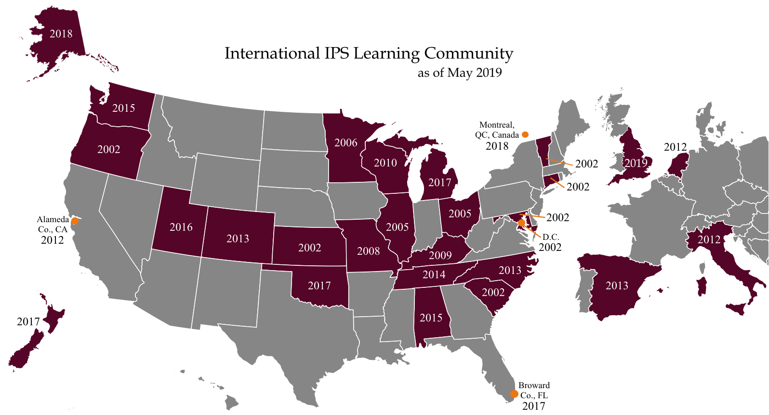
U.S. includes 243 agencies with 309 IPS teams

Slide 25
2019 National Survey Update: Preliminary Findings
IPS Programs in 24 IPS Learning Community States

Slide 26
Implications of National Survey Update
Number of learning community states continue to grow
2016 national survey also may have resulted in an undercount within learning community states
Spread of IPS is greater than previously reported
Access to services still very low (<5% of those who could benefit)

Slide 27
Summary
IPS research continues to show its effectiveness in improving employment outcomes
IPS has “scaled up and out” in many directions – new countries, new populations, new IPS teams
Documentation of recent research is updated annually and posted at ipsworks.com

Slide 28
Where to Find
Latest IPS Research Findings
https://ipsworks.org
↓
What is IPS
↓
Evidence for IPS
↓
Resources

