Slide 1
Evidence for the Effectiveness of Individual Placement and Support Model of Supported Employment
Updated 7-28-16 by Gary Bond

Slide 2
Why Focus on Work?
Most clients want to work!
Most clients see work as an essential part of recovery
Being productive = Basic human need
In most societies, typical adult role
Working can be a way out of poverty
Working may prevent entry into disability system
Notes:
Working is often mentioned by clients in describing their recovery process. For example:
J. Bailey, “I’m an Ordinary Person,” Psychiatric Rehabilitation Journal, 22, (1998), 8-10.
Rogers, J. A. (1995). Work is key to recovery. Psychosocial Rehabilitation Journal, 18(4), 5-10.
Steele, K., & Berman, C. (2001). The day the voices stopped. New York: Basic Books.
Hierarchy of needs: Maslow, A. H. (1970). Motivation and personality (2nd ed.): Harper & Row.
Working is not the only adult role for adults in our society, but it is clearly very important. It is each client’s choice whether or not he/she would like to pursue work, but mental health centers should make it possible if it is their choice.

Slide 3
Expressed Interest in Employment
Reported in 10 Surveys

Slide 4
From a young person who attends a psychosocial rehab (PSR) program:
I want to work because it is the only way I will not be in this program when I am old.
People don’t want to retire from PSR!!

Slide 5
Role of Work in Recovery Process: Work is the best treatment we have

Slide 6
Need for IPS
2/3 clients with severe mental illness want to work, but only ~15% employed.
Until the 1990s, no effective models for helping clients achieve stable competitive employment.
Even today, only 2% of people who could benefit have access to effective employment services

Slide 7
Four Trends in IPS Research
Expanding the evidence base
Assessing applicability of IPS for target subgroups
Extending IPS to groups beyond people with severe mental illness
Developing strategies to disseminate, implement, sustain, and expand IPS

Slide 8
1. Expanding the evidence base
Number of studies showing IPS effectiveness continues to grow
Long-term outcomes are more positive than previously known
IPS produces a good return on investment
Steady employment promotes improvement in other life domains

Slide 9
Day Treatment Conversions to IPS: Common Study Design
Discontinued day treatment
Reassigned day treatment staff to new positions
Implemented new IPS program
Compared to 3 sites not converting
Sources: Drake and Becker

Slide 10
Day Treatment Conversion Studies: 6 Sites Converting to IPS vs. 4 Control Sites (Not Converting)
Notes:
Bond, G. R. (2004). Supported employment: Evidence for an evidence-based practice. Psychiatric Rehabilitation Journal, 345-359.

Slide 11
Similar Results in All Day Treatment Conversions
Large increase in employment rates
No negative outcomes (e.g., relapses)
Clients, families, staff liked change
Most former day treatment clients spent more time in community, even those not working
Resulted in cost savings

Slide 12
23 Randomized Controlled Trials of Individual Placement and Support (IPS)
Best evidence available on effectiveness
RCTs are gold standard in medical research
(Drake et al., 2016)

Slide 14
Competitive Employment Rates in 23 Randomized Controlled Trials of IPS

Slide 15
Overall Findings for 23 RCTs
All 23 studies showed a significant advantage for IPS
Mean competitive employment rates for the 23 studies:
55% for IPS
23% for controls
Meta-analysis of 17 RCTs of IPS found a risk ratio of 2.40
(Modini, 2016)

Slide 16
18-Month Competitive Employment Outcomes in 4 Controlled Trials of IPS
(Bond, Drake & Campbell, 2012)

Slide 17
Mean Job Tenure in Two IPS Studies
Job tenure for IPS was triple that for usual services in Hoffman study.

Slide 18
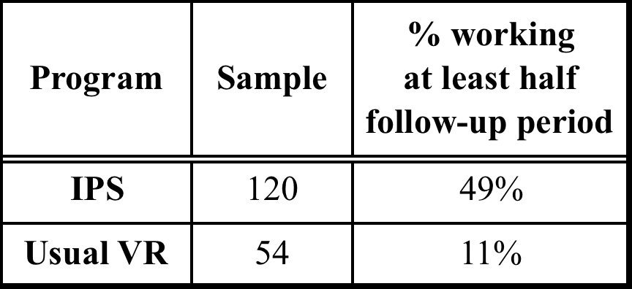
Steady Worker Rate in 3 Long-Term Studies
Hoffmann (2014): 5 year follow-up
Salyers (2004): 10 year follow-up
Becker (2007) 8-12 year follow-up

Slide 19
5-Year Return on Investment for IPS and Traditional Voc Services (Hoffmann, 2014)

Slide 20
Impact of Competitive Employment on Nonvocational Outcomes
Domains with positive impact reported in multiple studies:
Self esteem – 100% (3/3 studies)
Symptoms – 57% (4/7 studies)
Life satisfaction – 33% (3/9 studies)
(Luciano, Bond, & Drake, 2014)

Slide 21
2. Assessing applicability of IPS in target subgroups
Recent research on IPS for:
Social Security disability beneficiaries
Young adults experiencing first episode of psychosis
Transition age youth
People with criminal justice involvement

Slide 22
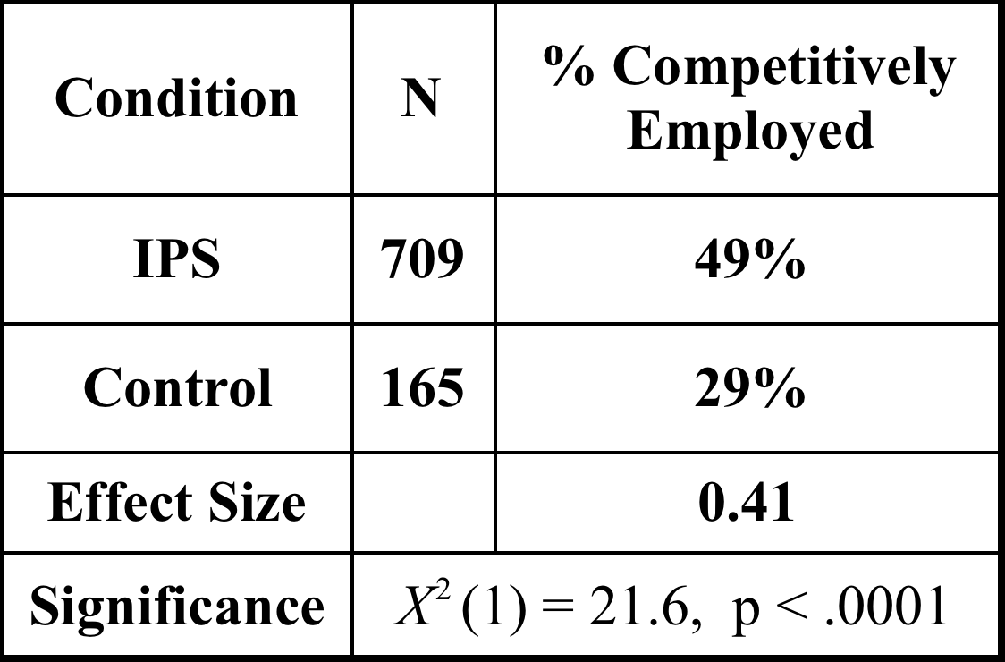
Systematic Review of Early Psychosis Literature (Bond et al., 2015): 8 Follow-up Studies of Early Intervention Programs Providing IPS

Slide 23
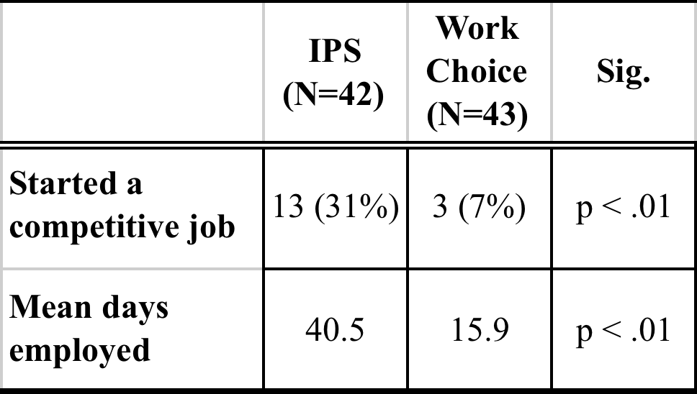
Chicago IPS Study of Clients with Severe Mental Illness and Justice Involvement: One-Year Outcomes (Bond et al., 2015)

Slide 24
IPS Is Effective in a Wide Variety of Target Populations
PTSD diagnosis
Mental illness + substance use
Older adults
First episode of psychosis
Homeless
Criminal justice history
Disability beneficiaries
African American
Hispanic

Slide 25
3. Expanding IPS to new populations
People with:
Spinal cord injuries
Autism spectrum disorders
Intellectual disabilities
Traumatic brain injury
Substance use disorders
Common mental disorders
Chronic medical conditions

Slide 26
Status of Research on IPS for New Populations (beyond severe mental illness)
Most studies in very early stages
Possibilities are exciting, but we advise caution until research completed

Slide 27
4. Developing strategies to disseminate, implement, sustain, and expand IPS
Evolution of IPS learning community developed by Dartmouth
Emergence of other IPS learning communities (New York state, Veterans Health Administration)

Slide 28
International IPS Learning Community
20 states/regions in US
(259 IPS teams at 202 sites)
3 European countries
(as of February 2016)

Slide 29
Growth of IPS Learning Community
Started with 3 pilot states in 2001
Number of participating states increased from 14 to 20 in last 4 years
Remarkable growth within states in number of sites
In 2013 survey, state leaders in 10 (77%) of 13 states said they were expanding

Slide 30
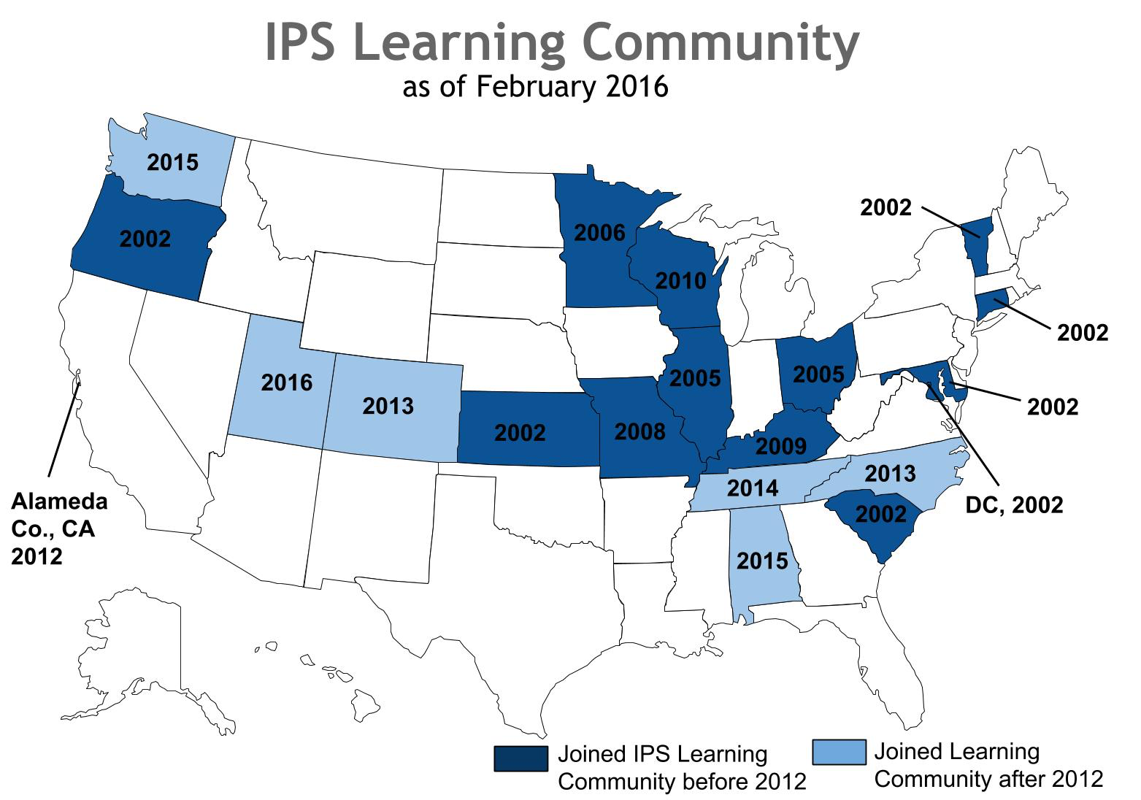

Slide 32
Most programs in IPS Learning Community meet fidelity standards
(Bond et al., 2012)

Slide 33
Sustainment of IPS Programs within IPS Learning Community

Slide 34
Positive Changes in 122 Sites in IPS Learning Community

Slide 35
4. Developing strategies to disseminate, implement, sustain, and expand IPS
Summary
Learning communities show great promise for promoting IPS
Practical experience has outpaced formal research

Slide 36
Current Trends in IPS: Overall Conclusions
Amazing growth and attention to IPS worldwide
Mike Hogan: IPS has reached a tipping point
Many new IPS research studies
Overheard at a meeting: “IPS has gone viral”

